Slide 1
Case study on COVID
Carmen Ambrosone – February 2021

Slide 2
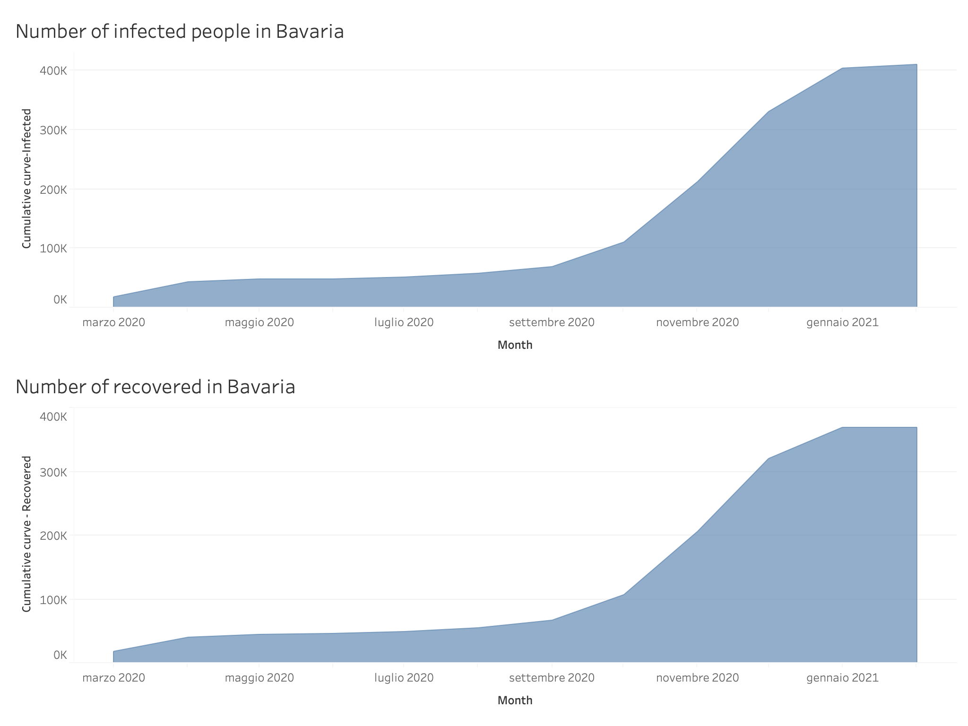

Slide 3
